Slide 1
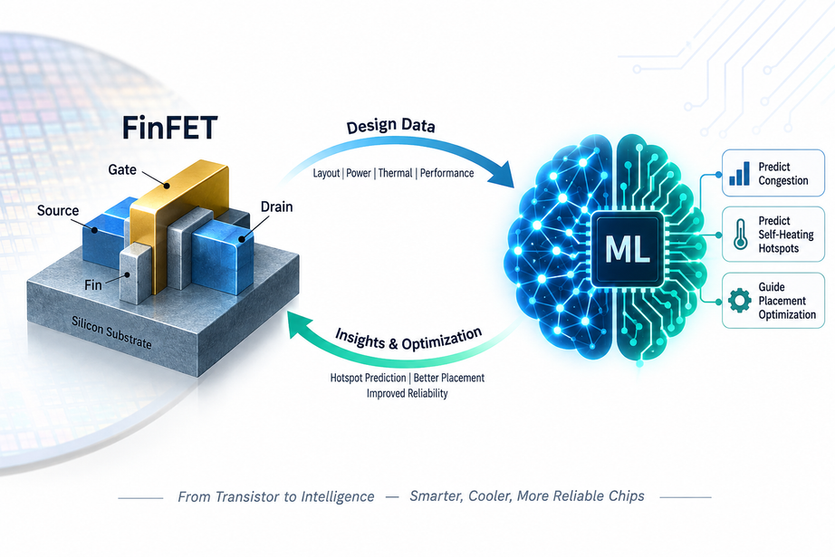
MACHINE LEARNING-BASED EARLY PREDICTION OF ROUTING CONGESTION AND SELF-HEATING HOTSPOTS IN ASAP7 FINFET PHYSICAL DESIGN”
~ Streamlining FinFET Layout Optimization Using Machine Learning
Presented by
R. SUHAS
K. BHAVANA

Slide 2
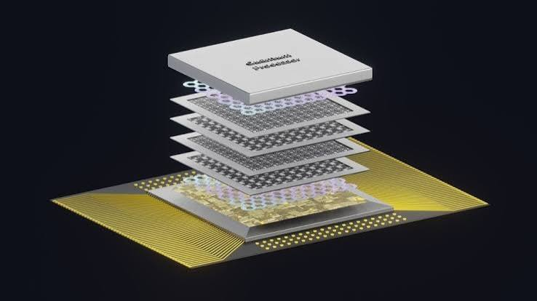
INTRODUCTION
  Advanced FinFET technologies face increasing challenges in physical design due to high device density, limited routing resources, and increased power density.
  Routing congestion can cause routing failures, design-rule violations, and timing degradation.
  Self-heating occurs when power dissipation raises the temperature of FinFET devices, affecting performance and reliability.
  These hotspots are often identified at later stages of the physical-design flow, making corrections more costly.
  Machine learning can use early physical-design and activity features to predict congestion and self-heating hotspots in advance.
  This work explores ML-based hotspot prediction using the ASAP7 7-nm FinFET platform to support early physical-design optimization.

Slide 3
PREVIOUS RESEARCH AND THE REMAINING GAP
1. ML for Routing Congestion / DRC Prediction
2. ML for FinFET Self-Heating Prediction
3. ML-Based Processor-Level Self-Heating Analysis
4. Thermal-Aware ML Placement
------------------------- . ----------------------------
Difference in our initiative:
Previous works mainly treat routing congestion and self-heating as separate problems. Our work aims to predict both hotspot types early, after initial placement and before detailed routing, and use the combined prediction to guide placement optimization in an ASAP7 FinFET design.

Slide 4
BENCHMARK DESIGN – 8-BIT LOW-POWER PROCESSOR
  8-bit Low-Power Processor — ALU, registers, control unit, program counter, memory, and data paths.
  ASAP7 FinFET RTL-to-Physical Design Flow — Synthesis → Placement → Routing, with different workloads/switching activities.
  Evaluation Metrics — Routing congestion, self-heating/temperature, timing, power, and area.
WHY THIS BENCHMARK?
  The 8-bit processor provides a realistic combination of logic complexity, different activity levels, and spatially distributed cells, making it suitable for studying both routing congestion and self-heating in the same physical-design environment.

Slide 5
AGENDA
1
2
3
BENCHMARK & PHYSICAL DESIGN
ML HOTSPOT PREDICTION & PLACEMENT OPTIMIZATION
PERFORMANCE EVALUATION
Compare power, timing, area, congestion, and temperature before and after optimization for different designs.
8-bit processor → asap7 synthesis, placement and routing.
Predict congestion and self-heating hotspots and refine placement.

Slide 6
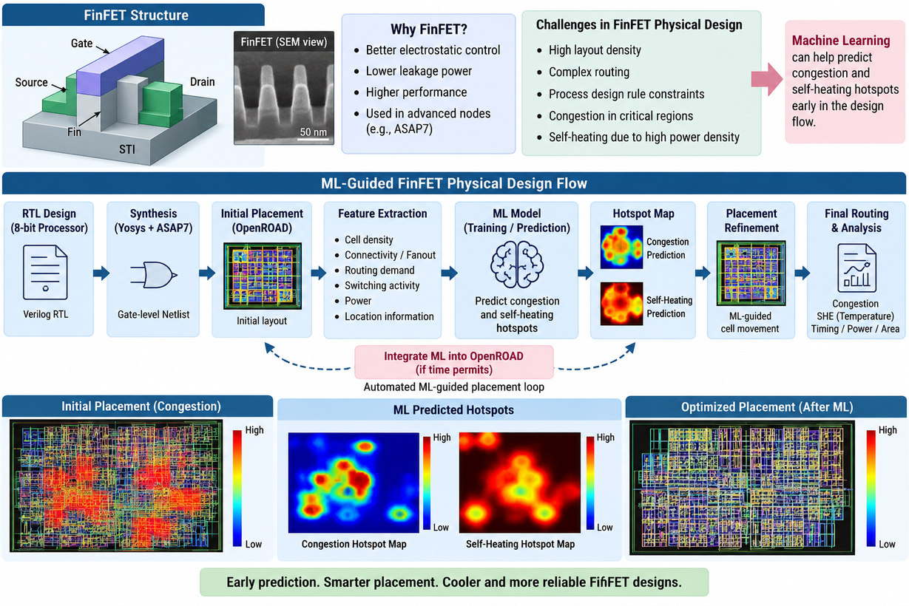
Initial Placement
↓
Feature Extraction
↓
• Cell Density
• Connectivity/Fanout
• Routing Demand
• Switching Activity
• Power
↓
Generate Ground Truth
↓
┌────────────|
↓ ↓
Congestion Map Thermal/SHE Map
┴───────────────┘
↓
Train ML Model
↓
Predict Hotspots
↓
┌────────┐
↓ ↓
Congestion Hotspot SHE Hotspot
└──────────────┘
↓
Placement Refinement
↓
Re-run PD
IMPLEMENTATION

Slide 7

WHAT IF TIME PERMITS!
Where OpenROAD integration comes in
Once the basic ML pipeline is working, we can take the project one step further:
OpenROAD Initial Placement
↓
Feature Extraction
↓
ML Model
↓
Hotspot Prediction
↓
Placement Refinement
↓
OpenROAD Re-run
↓
ML Integration (Time Permits)
↓
Automated ML-Guided Placement
↓
Final Routing
↓
Congestion + SHE Analysis
↓
PPA & Thermal Comparison

Slide 8

THE END

